Slide 1
Programming fundamentals (java) Practice 3
Primitive Data types(Byte, short, Int ,Long, Double, float, Char, Boolean).

Slide 2
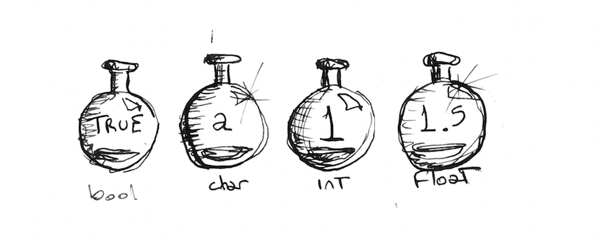
Variables
class TestType{
public static void main (String args[])
{
byte varByte;
varByte= 20;
System.out.println (varByte);
int varInt1=280;
int varInt2=90;
int sumValues= varInt1+varInt2+varByte;
System.out.println(sumValues);
char charVar= 'A' ;
System.out.println(charVar);
float floatvar=2.8f;
double doublevar=floatvar+ 8.9;
System.out.println(doublevar);
}
}

Slide 3
Write swap code
The following steps are algorithm of swapping simply:
Declare and initial num1
Declare and initial num2
Declare temporary variable (tempVar)
Let tempVar equal to num1
Num1 equal to num2
Num2 equal to tempVar
change the above steps to java code.

Slide 4
Swap answer
public class SwapElementsExample {
public static void main(String[] args) {
int num1 = 10;
int num2 = 20;
System.out.println("Before Swapping");
System.out.println("Value of num1 is :" + num1);
System.out.println("Value of num2 is :" +num2);
//swap the value
int temp = num1;
num1 = num2;
num2 = temp;
System.out.println("After Swapping");
System.out.println("Value of num1 is :" + num1);
System.out.println("Value of num2 is :" +num2);
}
}

Slide 5
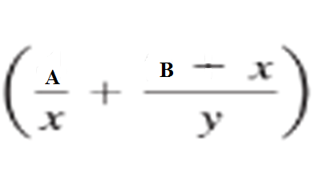
practice
Write a Program To find the value of Z when (X=2, Y=3.2, A=4.9, B= 13).
Z =

